Slide 1
Python 3
Something Nice here
Joel Enrique Esparza Ramirez
Internet of Things

Slide 2
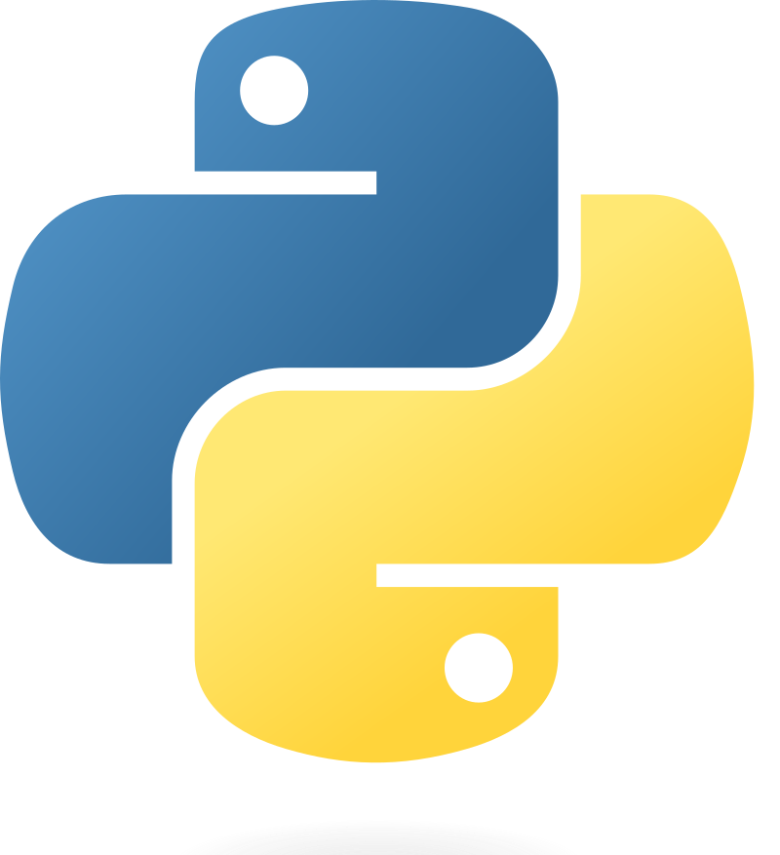
welcome

Slide 3
Introduction
Part 1

Slide 4
Python
Python is a high-level, interpreted programming language known for its simplicity and readability. It was created by Guido van Rossum and first released in 1991. Python's design philosophy emphasizes code readability with its use of significant indentation. Its language constructs and object-oriented approach aim to help programmers write clear, logical code for small and large-scale projects.

Slide 5
Interpreted Language
Python code is executed line by line, which makes debugging easier but may result in slower execution compared to compiled languages.

Slide 6
Dynamically Typed
Python does not require explicit declaration of variable types. The type is inferred at runtime, which adds flexibility but requires careful consideration to avoid type-related errors.

Slide 7
Multi-Paradigm
Supports different programming paradigms including procedural, object-oriented, and functional programming.

Slide 8
Extensive Standard Library
Comes with a large standard library that includes modules and packages for various functionalities, reducing the need for external libraries.

Slide 9
Cross-Platform Compatibility
Python programs can run on various operating systems without requiring changes to the code.

Slide 10
Indentation
Uses whitespace indentation to define code blocks, making the code visually structured and readable.

Slide 11
Open Source
Python is developed under an OSI-approved open-source license, making it freely usable and distributable, even for commercial use.

Slide 12
Strong Community
Has a large and active community, providing extensive support, documentation, and a vast array of third-party tools, libraries, and frameworks.

Slide 13
Applications
Widely used in web development, data science, artificial intelligence, scientific and numeric computing, software development, and system scripting.

Slide 14
HOW TO INSTALL PYTHON
https://www.python.org/downloads/

Slide 15
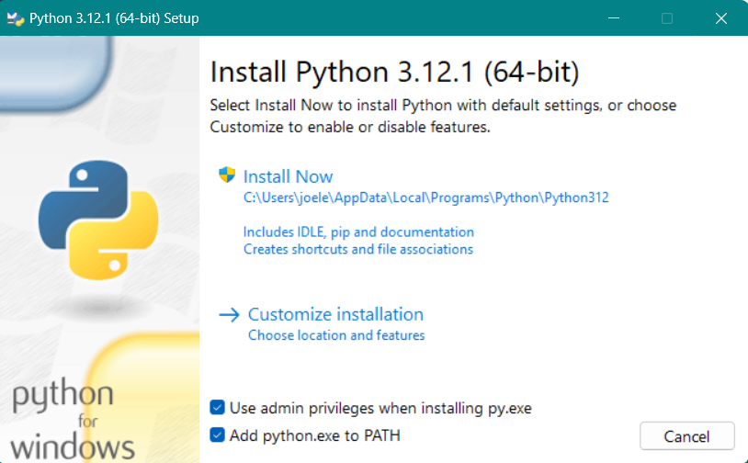

Slide 16
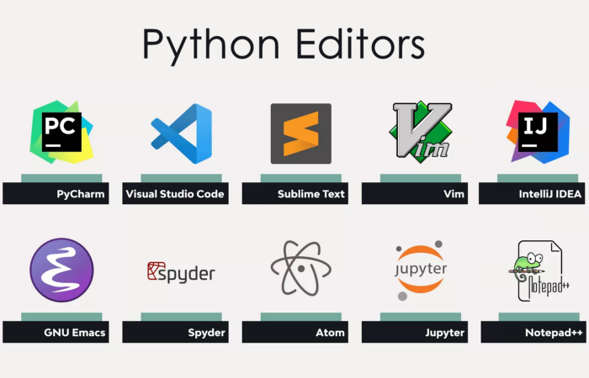
Install text editor

Slide 17
Hello world
Lecture 1

Slide 18
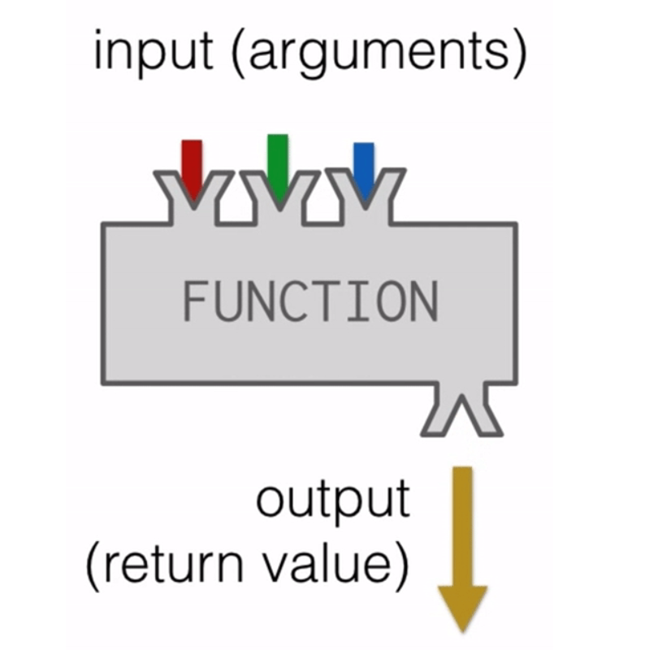


BUILT-IN FUNCTIONS

Slide 19
PART 1
Values and data types

Slide 20
Variables
A variable in Python is a reserved memory location to store values. In other words, a variable in a Python program gives data to the computer for processing.

Slide 21
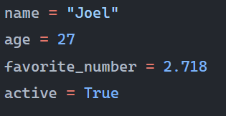
Assignment
Snake Case: Typically used for variable names. Example: my_variable.

Slide 22
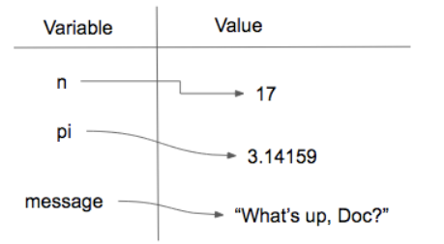

Slide 23
VARIABLES
Lecture 2

Slide 24
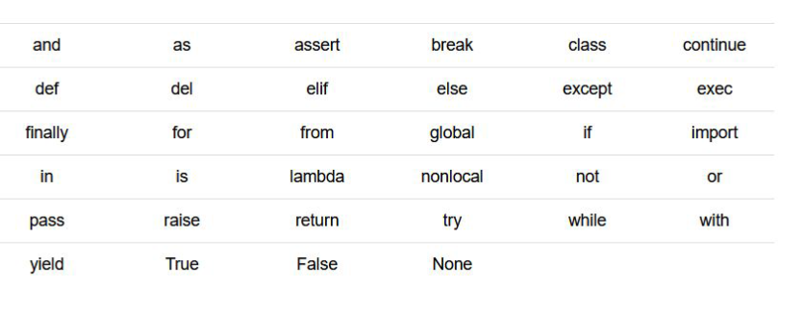
Exceptions

Slide 25
VALUES
INT
FLOAT
STRING
BOOLEAN

Slide 26
Type()
The type() function in Python is a built-in function that returns the type of an object. This means it tells you what class a variable or a value belongs to. The type() function is commonly used for debugging and development purposes, allowing developers to check the data types of variables and understand how to work with them effectively.

Slide 27
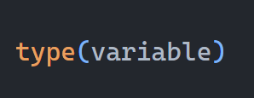

Slide 28
VALUEs
Lecture 3

Slide 29
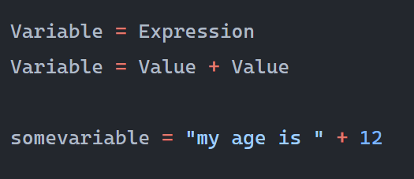
expressions

Slide 30
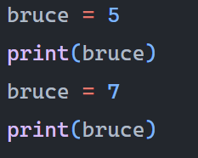
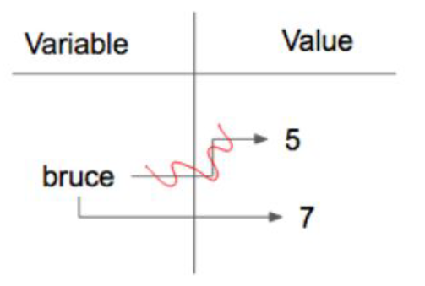
Reassignment

Slide 31
PART 1
Operators and Operands

Slide 32
Operators and Operands
In Python, operators are special symbols that carry out arithmetic or logical computation. The value(s) that the operator operates on are called operands.

Slide 33
Arithmetic Operators
+ Addition: Adds two operands. Ex: x + y
- Subtraction: Subtracts two operands. Ex: x - y
* Multiplication: Multiplies two operands. Ex: x * y
/ Division: Divides the first operand by the second. Ex: x / y

Slide 34
Arithmetic Operators
% Modulus: Returns the remainder when first operand is divided by the second. Ex: x % y
** Exponentiation: Raises the first operand to the power of the second. Ex: x ** y
// Floor division: Division that results into whole number adjusted to the left in the number line. Ex: x // y

Slide 35
Arithmetic Operators
Lecture 4

Slide 36
Exercise 1: Basic Arithmetic with Integers and Floats
Write a program that calculates the average of three numbers: an integer 15, a float 6.5, and another integer 22. Assign the result to a variable called average and print it out.

Slide 37
Exercise 2: String Concatenation and Repetition
Create a program that concatenates the following strings: "Python" and "3.8", separated by a space, and then repeat this concatenated string 3 times. Store the result in a variable called repeated_string and print it out.

Slide 38
Exercise 3: Mixing Strings and Numbers
Write a program that takes an integer variable age with a value of 30 and a string variable greeting with the value "Hello, I am ". Concatenate greeting with age to form a complete sentence. You will need to convert the integer to a string before concatenation. Print the result.

